Slide 1

University Institute of Engineering
DEPARTMENT OF COMPUTER SCIENCE & ENGINEERING
Internet of Things-IoT
(20CST-357) & Lab (20CSP-358)
Prepared by: Er. Parveen Badoni (E13737)
Master Subject Coordinator
DISCOVER . LEARN . EMPOWER

Slide 2
Vision of the University
“To be globally recognized as a Centre of Excellence for Research, Innovation, Entrepreneurship and disseminating knowledge by providing inspirational learning to produce professional leaders for serving the society.”

Slide 3
Mission of the University
M1: Providing world class infrastructure, renowned academicians and ideal environment for Research, Innovation, Consultancy and Entrepreneurship relevant to the society.
M2: Offering programs & courses in consonance with National policies for nation building and meeting global challenges.
M3: Designing Curriculum to match International standards, needs of Industry, civil society and for inculcation of traits of Creative Thinking and Critical Analysis as well as Human and Ethical values.

Slide 4
Continued..
M4: Ensuring students delight by meeting their aspirations through blended learning, corporate mentoring, professional grooming, flexible curriculum and healthy atmosphere based on co-curricular and extra-curricular activities.
M5: Creating a scientific, transparent and objective examination/evaluation system to ensure an ideal certification.
M6: Establishing strategic relationships with leading National and International corporates and universities for academic as well as research collaborations.
M7: Contributing for creation of healthy, vibrant and sustainable society by involving in Institutional Social Responsibility (ISR) activities like rural development, welfare of senior citizens, women empowerment, community service, health and hygiene awareness and environmental protection.

Slide 5
Vision of the Department
To be recognized as a leading Computer Science and Engineering department through effective teaching practices and excellence in research and innovation for creating competent professionals with ethics, values and entrepreneurial attitude to deliver service to society and to meet the current industry standards at the global level.

Slide 6
Mission of the Department
M1: To provide practical knowledge using state-of-the-art technological support for the experiential learning of our students.
M2: To provide industry recommended curriculum and transparent assessment for quality learning experiences.
M3: To create global linkages for interdisciplinary collaborative learning and research.
M4: To nurture advanced learning platform for research and innovation for students’ profound future growth.
M5: To inculcate leadership qualities and strong ethical values through value based education.

Slide 7
Program Educational Objectives
The Program Educational Objectives of the Computer Science & Engineering undergraduate program are for graduates to achieve the following, within few years of graduation. The graduates of Computer Science & Engineering Program will
PEO1: Engage in successful careers in industry, academia, and public service, by applying the acquired knowledge of Science, Mathematics and Engineering, providing technical leadership for their business, profession and community
PEO2: Establish themselves as entrepreneur, work in research and development organization and pursue higher education
PEO3: Exhibit commitment and engage in lifelong learning for enhancing their professional and personal capabilities.

Slide 8
Course Objectives
To study Origins, Drivers and Applications of Internet of Things.
2. To study Internet of Things Communications Models.
3. To learn what issues does the Internet of Things raise.

Slide 9
Course Outcomes
CO1. Analyze the basic terminologies associated with IOT and use it.
CO2. Justify the applications of Internet of Things and correlate them.
CO3. Compare different objects and communication strategies and also able to see the issues raised by communication strategies in IoT.
CO4. Examine the protocols required for communication and packet size required for each application.
CO5. Illustrate security issues with IOT like security, privacy, communication standard and some other legal issues.

Slide 10
Program Outcomes (POs)
PO1: Engineering knowledge: Apply the knowledge of Mathematics, Science, Engineering fundamentals and computer science fundamental and strategies which have the solution of complex computer science engineering problems.
PO2: Problem analysis: Identify, formulate, research literature, and analyze complex computer science engineering problems reaching substantiated conclusions using first principles of mathematics, natural sciences, and engineering sciences.
PO3: Design/development of solutions: Design solutions for complex database and software engineering problems and design system components or processes that meet the specified needs with appropriate considerations for the public health and safety, and the cultural, societal, and environmental considerations.
PO4: Conduct investigations of complex problems: Use research-based knowledge and research methods including design of software engineering & networking based experiments, analysis and Interpretation of data, and synthesis of the information to provide valid conclusions.

Slide 11
Continued…
PO5: Modern tool usage: Create, select, and apply appropriate techniques, resources, and modern Computer science engineering and IT tools including prediction and modeling to complex database or software engineering activities with an understanding of the limitations.
PO6: The engineer and society: Apply reasoning informed by the contextual knowledge to assess
Social, health, safety, legal and cultural issues and the consequent responsibilities relevant to the Professional Computer Science & Engineering practice.
PO7: Environment and sustainability: Understand the impact of the professional computer science and engineering solutions in social and environmental contexts, and demonstrate the knowledge of, and need for sustainable development goals.
PO8: Ethics: Apply ethical principles and commit to professional ethics and responsibilities and norms of computer science engineering practice

Slide 12
Continued…
PO9: Individual and team work: Function effectively as an individual, and as a member or leader in diverse teams, and in multidisciplinary settings.
PO10: Communication: Communicate effectively on complex computer science engineering activities with the engineering community like CSI society at large, such as, being able to comprehend and write effective reports and design documentation, make effective presentations, and give and receive clear instructions.
PO11: Project management and finance: Demonstrate knowledge and understanding of the computer science engineering and management principles and apply these to one’s own work, as a member and leader in a team, to manage projects and in multidisciplinary environments.
PO12: Life-long learning: Recognize the need for, and have the preparation and ability to engage in independent and life- long learning in the broadest context of computer science engineering changes.

Slide 13
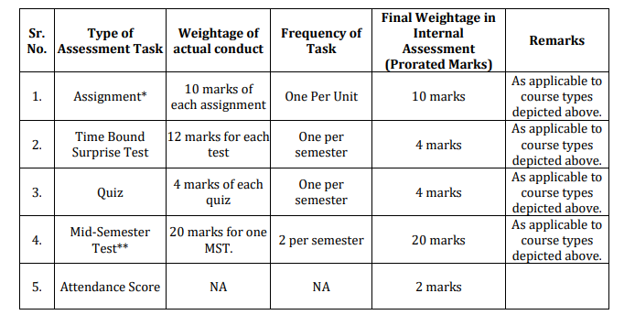
Internal Assessment

Slide 14
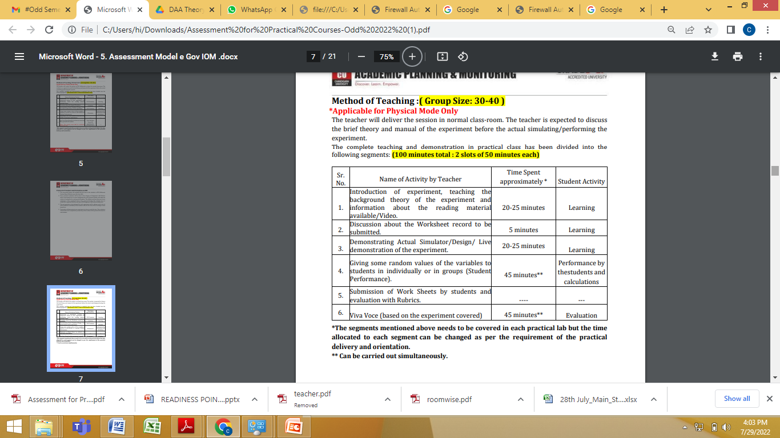
Method of teaching

Slide 15
IoT Syllabus
UNIT-I
[15h]
Chapter-1 (Introduction)
What is the Internet of Things, Components of IOT, Applications, Different Definitions, Similar Concepts, Sensing, Actuation, Smart Objects, Smart applications.
Chapter-2 (IOT Applications for Industry)
Value Creation and Challenges. IoT Today, IoT as a Network of Networks, Why Is IoT Important, IoT: Critical for Human Progression, Challenges and Barriers to IoT.

Slide 16
Syllabus
UNIT-II
[15h]
Chapter-3 (Internet of Things Communication Models)
Device – to – Device Communications, Device – to – Cloud Communications, Device – to - Gateway Model, Back - End Data - Sharing Model.
Chapter-4 (Issues Raised by Internet of Things)
Security Issues, The IoT Security Challenge, A Spectrum of Security Considerations, Unique Security Challenges of IoT Devices and Privacy.
Considerations: Internet of Things Privacy Background, Unique Privacy Aspects of Internet of Things, Interoperability.

Slide 17
Syllabus
UNIT-III
[15h]
Chapter-5 (Standard Issues)
IoT Interoperability / Standards Background, Key Considerations and Challenges in IoT Interoperability / Standards, Regulatory, Legal, and Rights Issues: Data Protection and Cross border Data Flows, IoT Data Discrimination, IoT Devices as Aids to Law Enforcement and Public Safety, IoT Device Liability.
Chapter-6 (Proliferation of IOT Devices)
Used in Legal Actions, Regulatory, Legal, and Rights Issues Summary, Emerging Economy and Development Issues: Ensuring IoT Opportunities are Global, Economic and Development Opportunities.
Chapter-7 (Case Study)
Case study on smart homes using Internet of things.
ADVANCED TOPICS (BEYOND SYLLABUS)
Mobile Cloud Services, IOT and Cloud Security, Smart Cloud and IOT

Slide 18
Text And Reference books
TEXT BOOKS
Ovidiu Vermesan, Peter Friess, “Internet of Things-Converging Technologies for Smart Environments & integrated Ecosystem”, River Publications Netherlands.
2. Internet Society, “An overview of Internet of Things”.
3. IoT Fundamentals: Networking Technologies, Protocols, and Use Cases for the Internet of Things by David Hanes, Gonzalo Salgueiro, Patrick Grossetete, CISO Press.
REFERENCE BOOKS
Pfister, Cuno, “Getting started with the Internet of Things: connecting sensors and microcontrollers to the cloud", O'Reilly Media, Inc.”, 2011.
2. Greenfield, Adam,” Everyware: The dawning age of ubiquitous computing”, New Riders, 2010.
3. The Internet of Things, revised and updated edition (The MIT Press Essential Knowledge series) by Samuel Greengard, MIT Press.

Slide 19
About IoT
IoT wants to connect all potential objects to interact each other on the internet to provide secure, comfort life for human.
Internet of Things (IoT) makes our world as possible as connected together. Nowadays we almost have internet infrastructure wherever and we can use it whenever. Embedded computing devices would be exposed to internet influence. Common instances for embedded computing devices are MP3 players, MRI, traffic lights, microwave ovens, washing machines and dishwashers, GPS even heart monitoring implants or biochip and etc.
IoT try's to establish advanced connectivity (with the aid of internet) among these mentioned device or systems or services in order to little by little makes automation in all areas. Image that all thing are connected to gather and all information would be interacted to each other over standard and different protocol domain and applications.

Slide 20
Advantages of IoT
1. Real-time asset/resource visibility.
2. Reduced costs.
3. Improved operational efficiency.
4. Data-driven insights for quick decision-making.
5. End-to-end, remote monitoring and management of assets/resources.
6. Real-time, predictive and prescriptive insights.
7. Improve end-customer experience.

Slide 21
Target Companies
TOP INTERNET-OF-THINGS (IOT) COMPANIES
Samsara
Arm
PTC
GE Digital
Verizon
Cisco
Telit
SoluLab
https://www.iotone.com/iotone100

Slide 22
Case Study of IoT
Lots of projects are associated with IoT
https://www.gsma.com/iot/smart-cities/case-studies/

Slide 23
IoT LAB 20CSP358

Slide 24
Course Objectives:
1. To study hardware and software related to IoT.
2. To understand the functions of Node MCU, Arduino Uno and Raspberry Pi.
3. To grasp knowledge about interfacing using non-wired connection.
Course Outcomes:
1. Analyze the components of IoT system. (BT-4)
2. Testing of model on IoT based Simulation. (BT-5)
3. Illustrate real time application using Node MCU/Arduino Uno/Raspberry Pi. (BT-3)
4. Develop an interface between controller and sensor to capture real time data. (BT-6)
5. Design an application to control actuators using wireless connectivity. (BT-6)

Slide 25
Syllabus
Unit 1
1. Familiarization with Arduino/Raspberry Pi hardware and perform necessary software installation. (CO-1)
2. Identification of different sensors used in IoT applications. (CO-1)
3. Demonstration of Autodesk Tinkercad Simulation Platform. (CO-2)
4. Program to interface the Arduino/Raspberry Pi with LED and blinking application. (CO-3)
Unit 2
5. To measure the distance of an object using an ultrasonic sensor. (CO-3)
6. Interfacing of Arduino/Raspberry Pi with temperature and humidity sensor with real time application. (CO-4)
7. To display data generated by sensor on LCD using Arduino/Raspberry Pi. (CO-4)
Unit 3
8. Interfacing Air Quality Sensor (MQ135) and display data on LCD. (CO-4)
9. Real time application of controlling actuators through Bluetooth application using Arduino. (CO-5)
10. Study the Implementation of Zigbee Protocol using Raspberry Pi/Arduino. (CO-5)

Slide 27
Practical Assessment Model
Continuous Assessment will be held for each and every experiment as follows:
WORK SHEET/REPORT: 10 Marks
CONDUCT: 12 Marks
VIVA VOCE: 08 marks

Slide 28
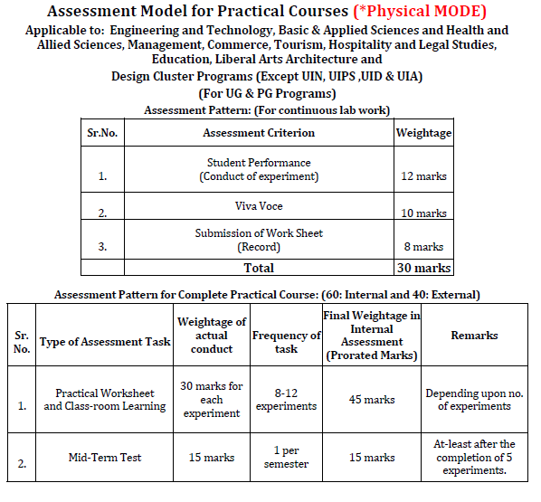
Practical Assessment model

Slide 29
Any Queries?

Slide 30
Thank you!!

